Slide 1
SALVATION QUEST
A CHAR DHAM expedition.

Slide 2
Purpose of Project
The purpose of our project is to provide an informational website which will provide users with all necessary information about a mesmerizing CHAR DHAM YATRA which is required for a comfortable and budget friendly journey.

Slide 3
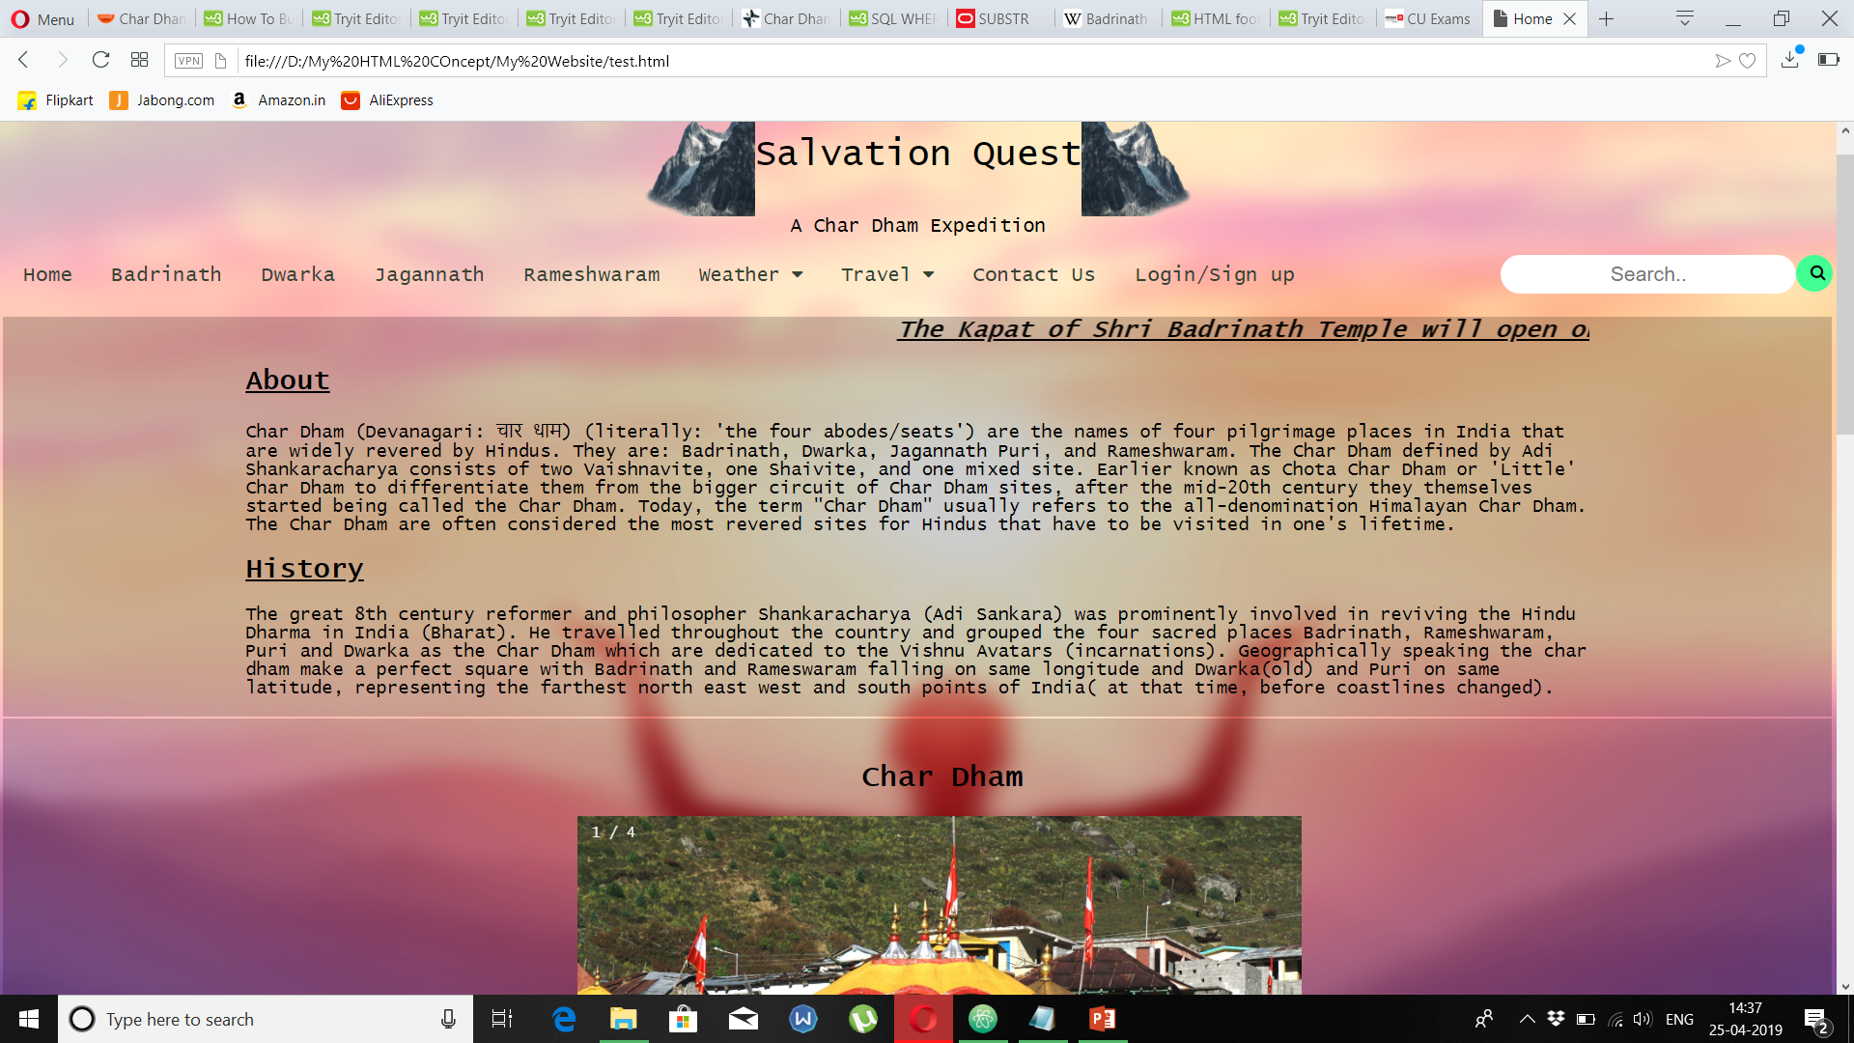
HOME PAGE

Slide 4
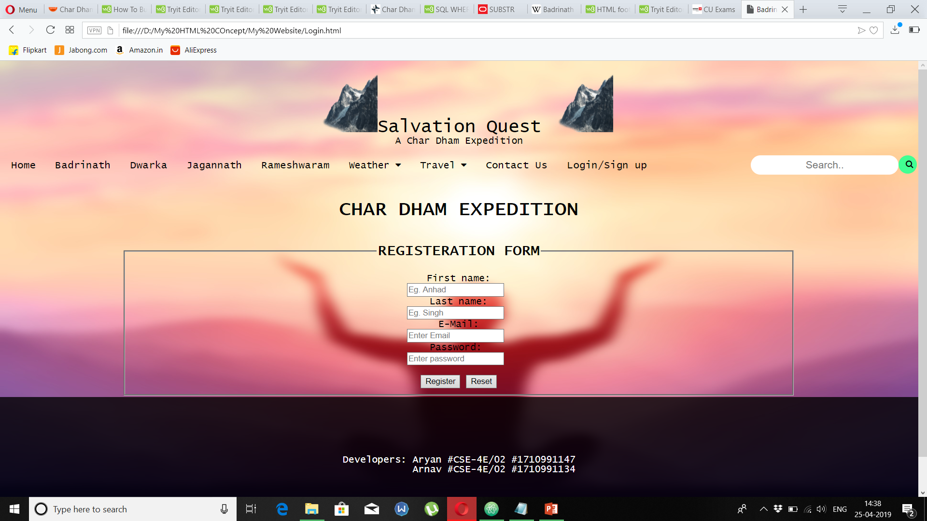
REGISTERATION FORM

Slide 5
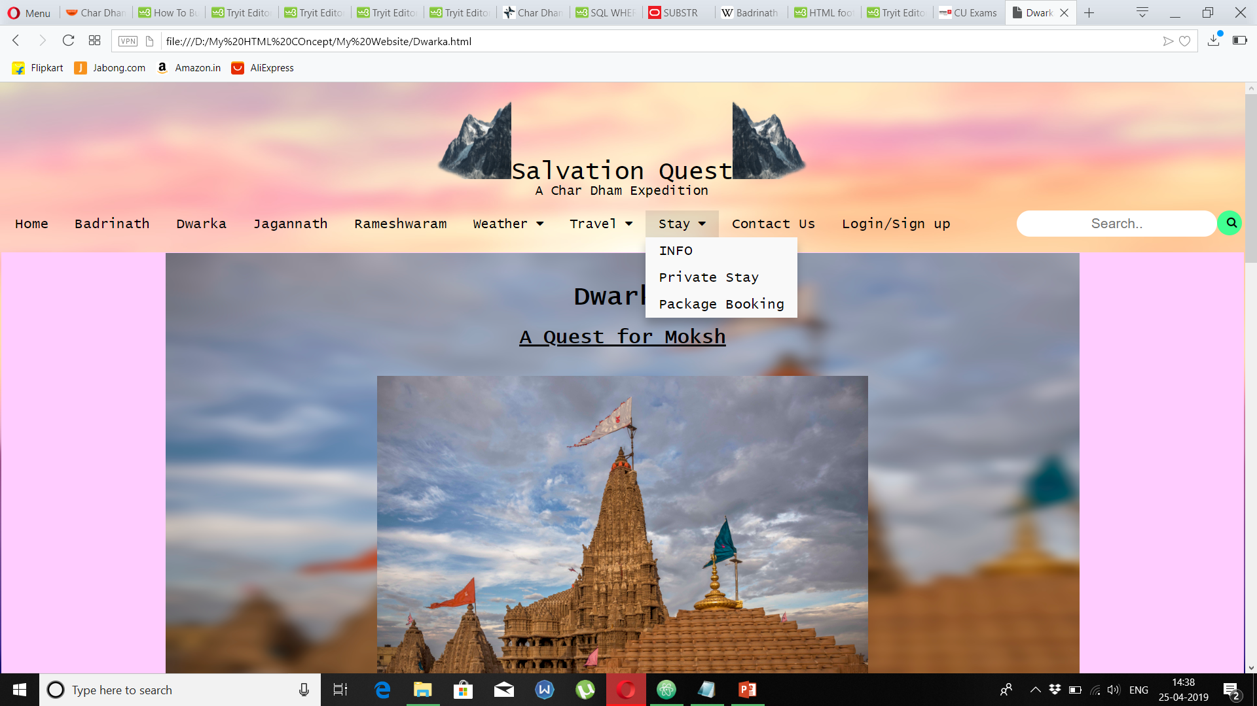
CONTENT PAGE

Slide 6
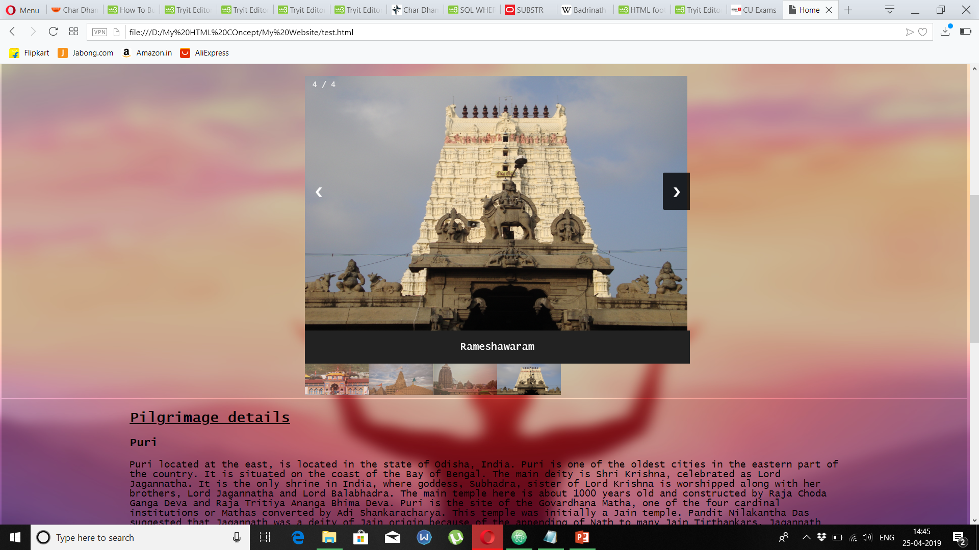
IMAGE GALLERY

Slide 7
Future Scope
The future scope of our website includes connecting this site to database and making it more dynamic site which will include each and every tourist spot in India or maybe abroad.
A blog space can be added where tourists can share their experiences and queries can also be asked.
Space is also provided for Advertisements.

